Slide 1



Jupyter Notebooks in European Plate Observing System (EPOS) as a learning tool
Jan Michalek, K. Giuliacci, L. Trani, A. Spinuso, R. Paciello, D. Bailo, V. Vinciarelli, J. Kocot, T. Hooijer, J.B. Roquencourt
and the EPOS IT Team (Marco Salvi, Mario Malitesta, Jean-Baptiste Roquencourt, Daniel Warren, Martin Carrere, Alessandro Turco and others)

Slide 2
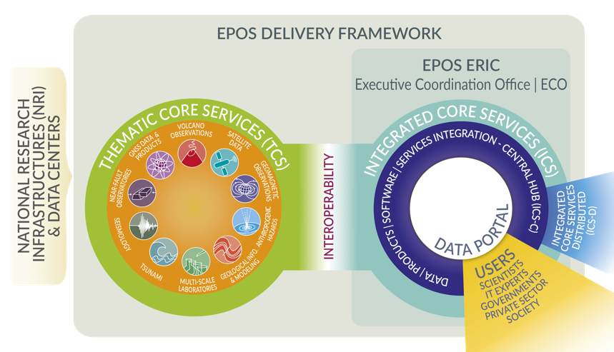

Slide 3
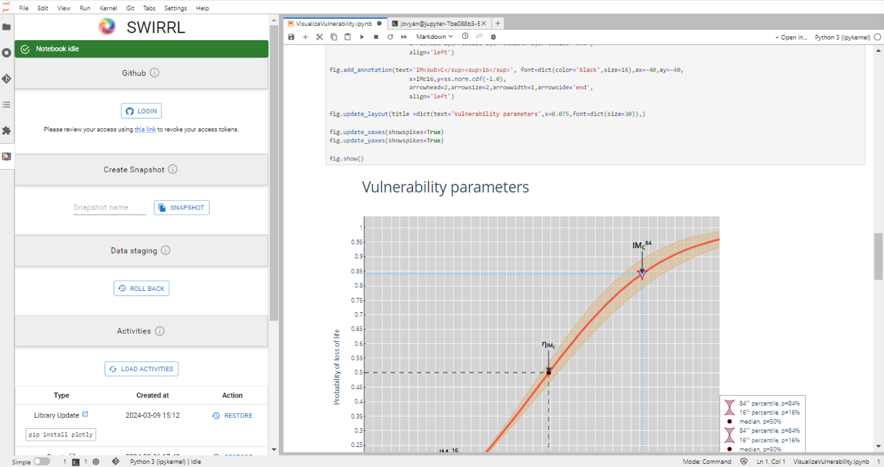


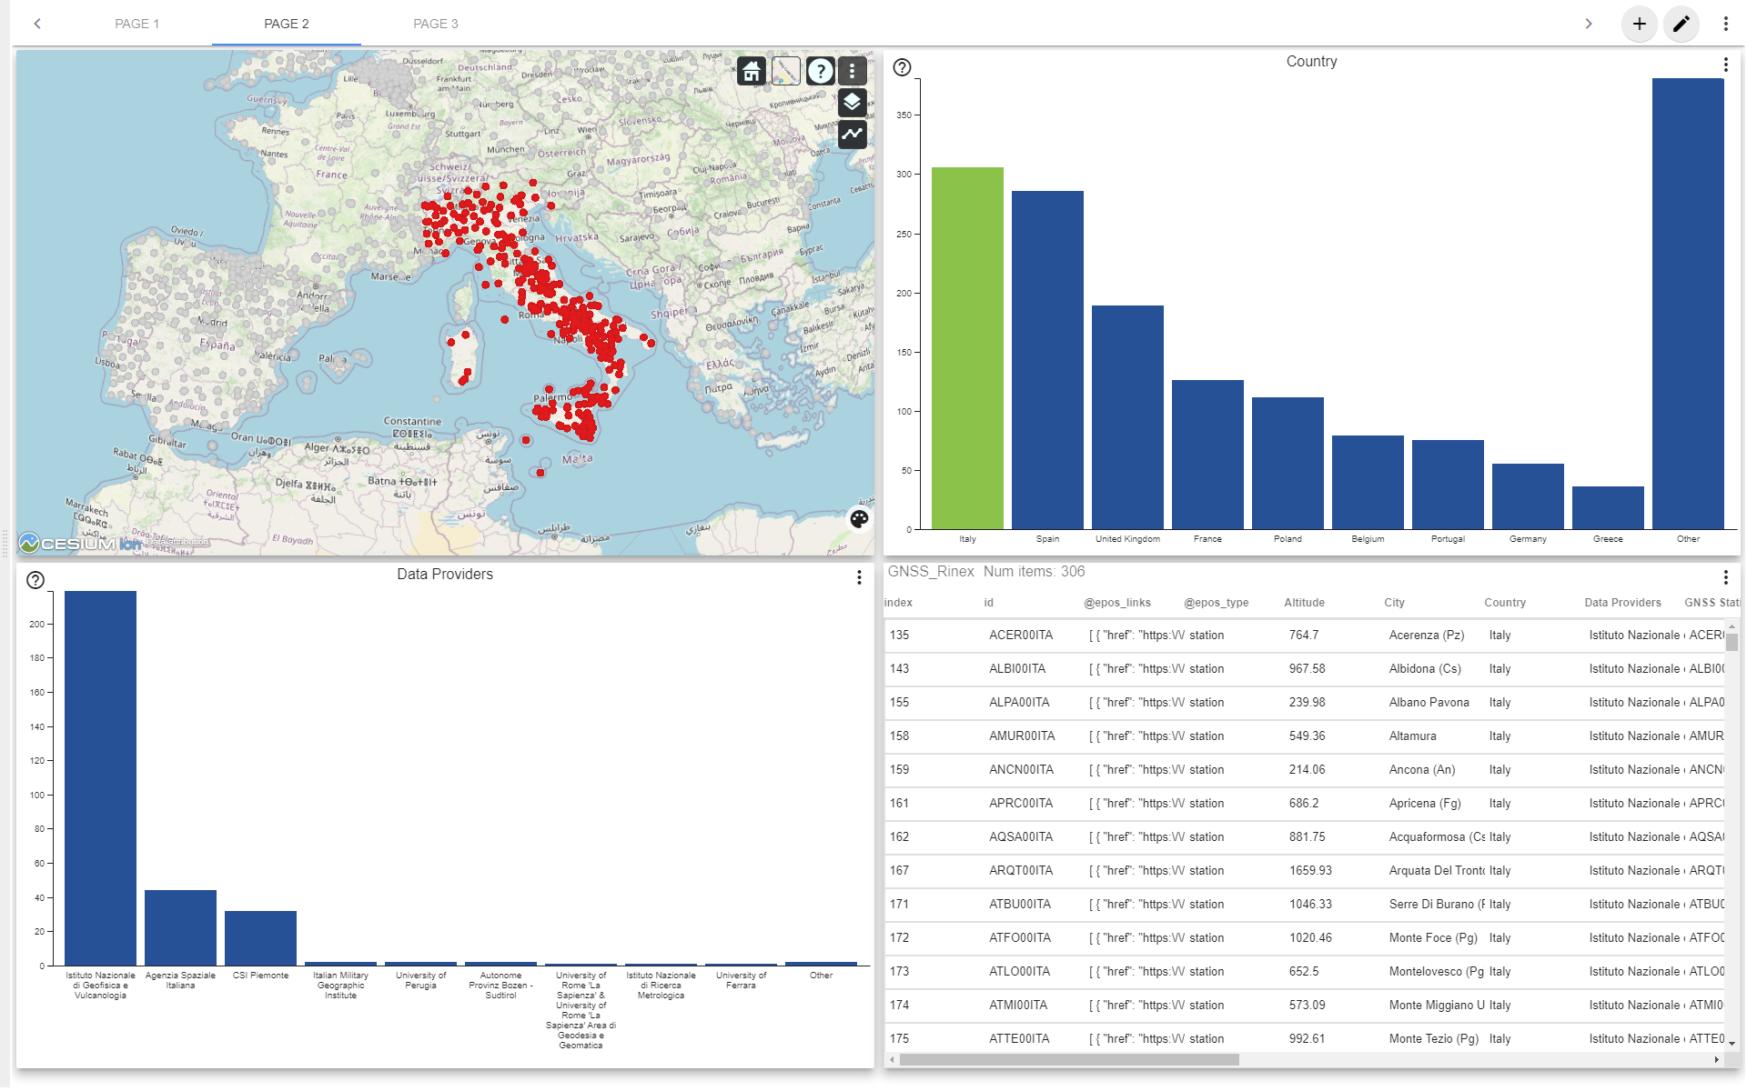
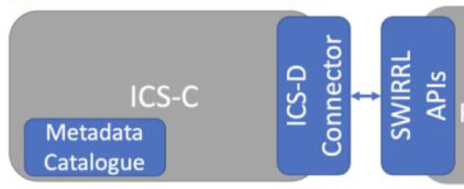



Virtual Research Environment in EPOS
Discover Data Resources
Associate them with Analysis Tools
ICD-D Connector
Seamless control
of multiple
types of ICS-D
Services
SWIRRL
TSU
Use Case
Data Staging & Preprocessing Provenance Tracking

Slide 4
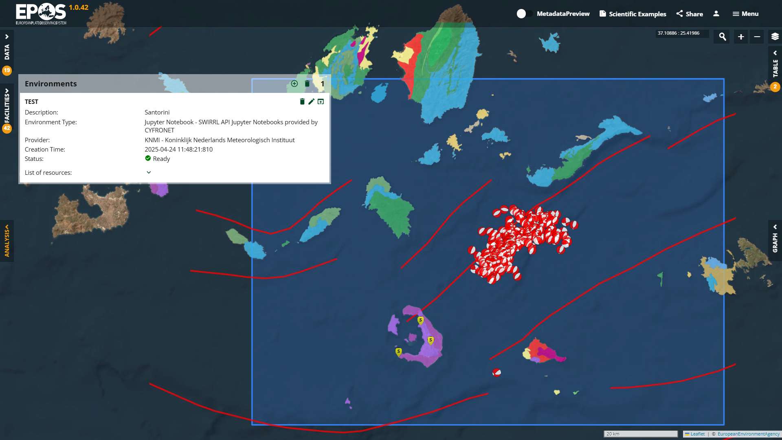

Slide 5
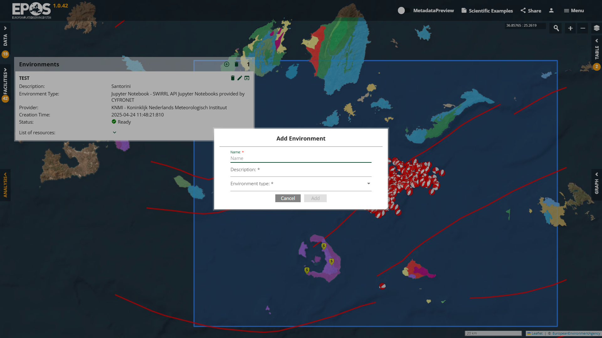

Slide 6
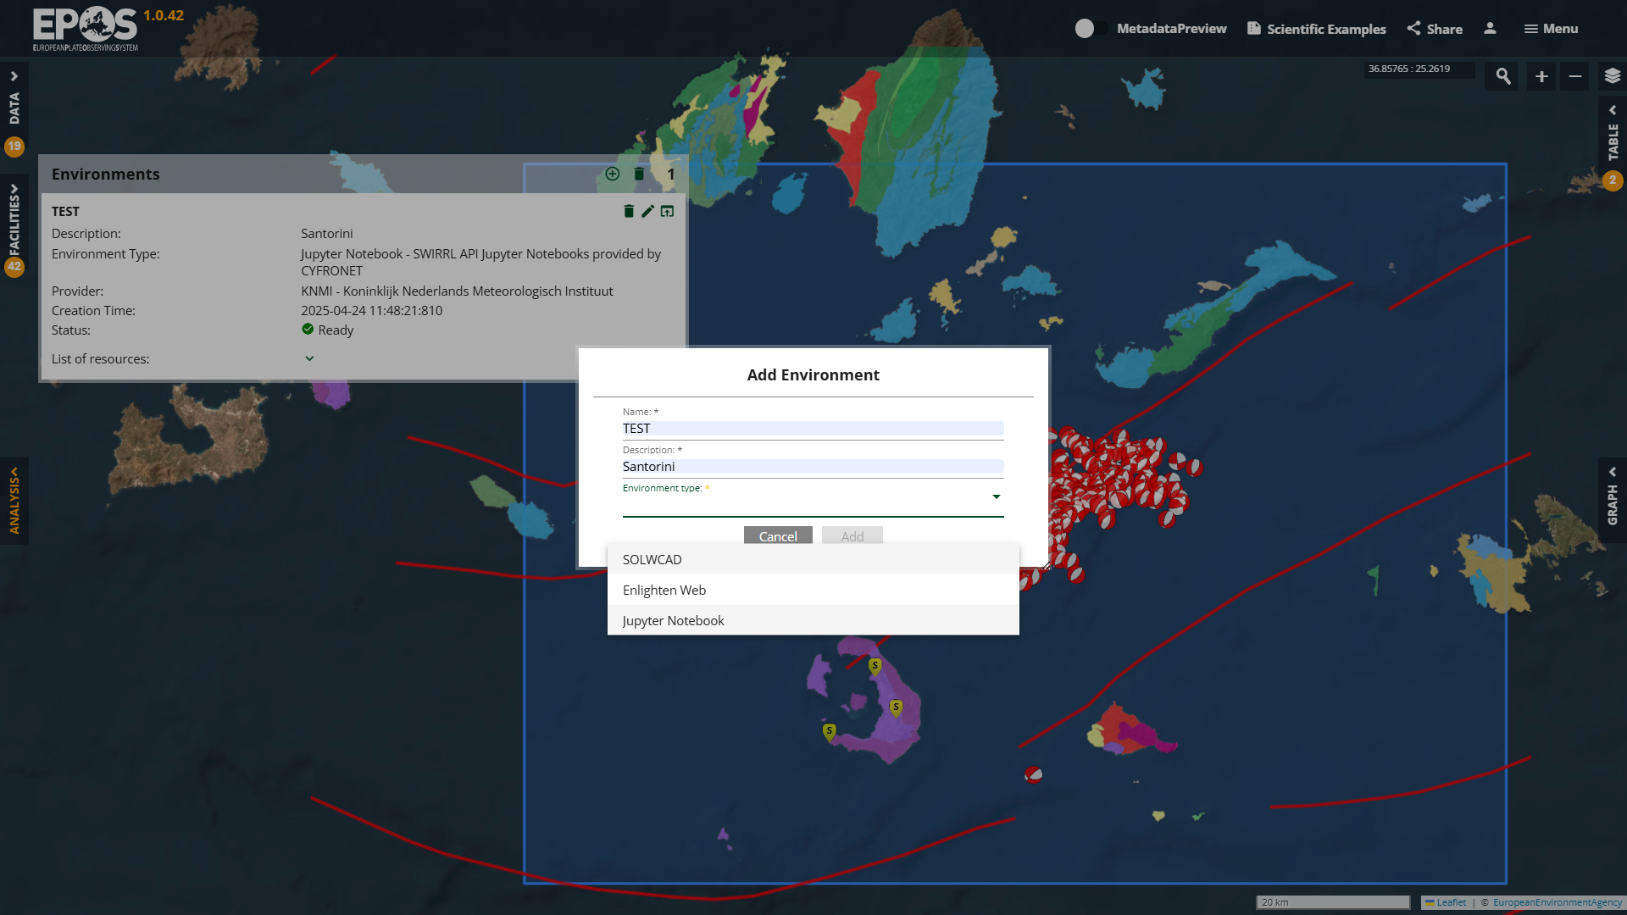

Slide 7
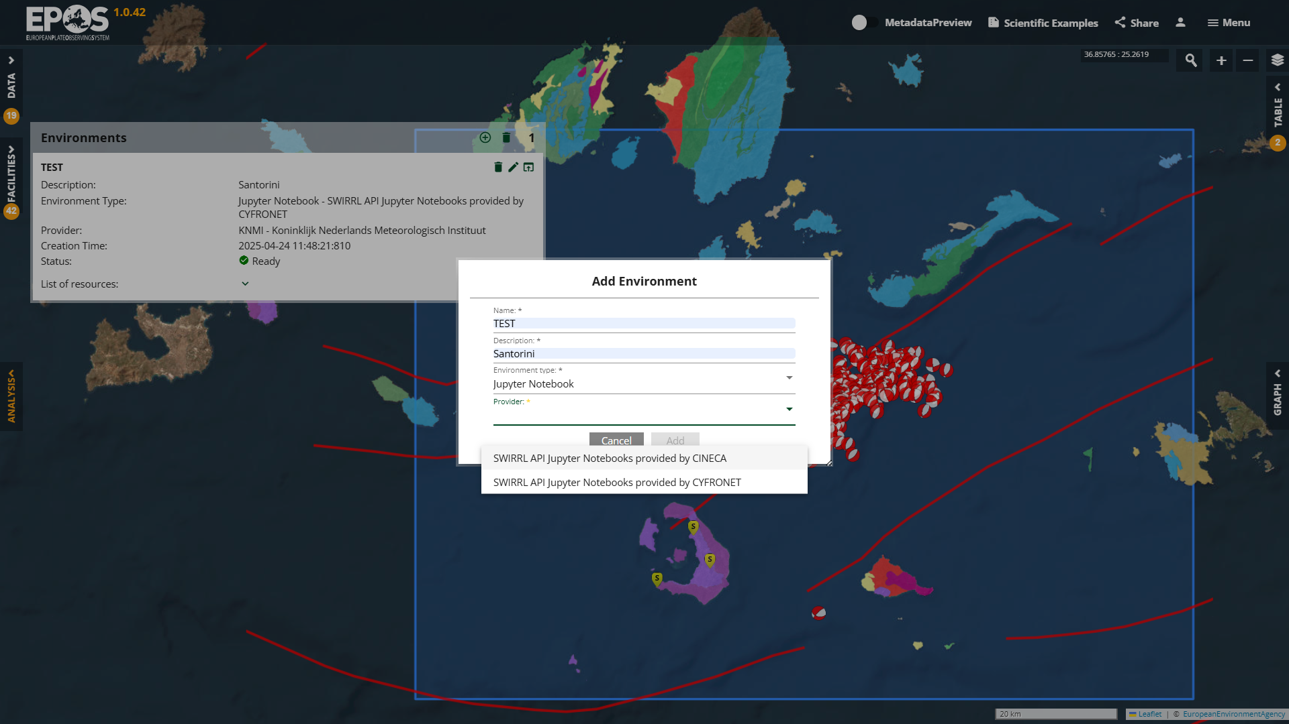

Slide 8
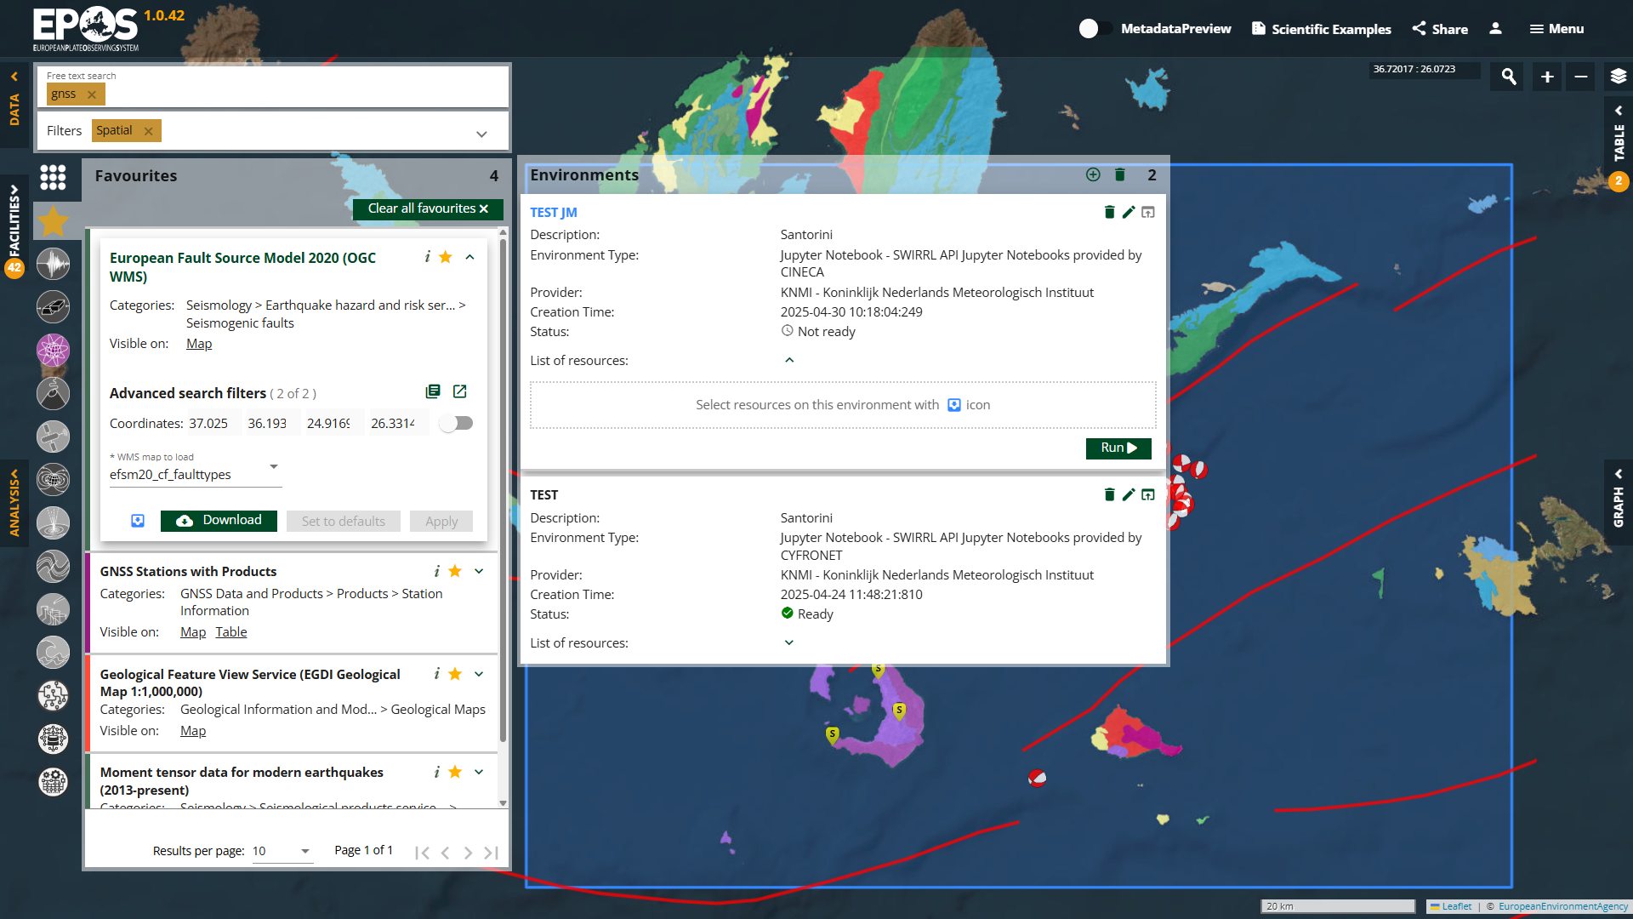

Slide 9
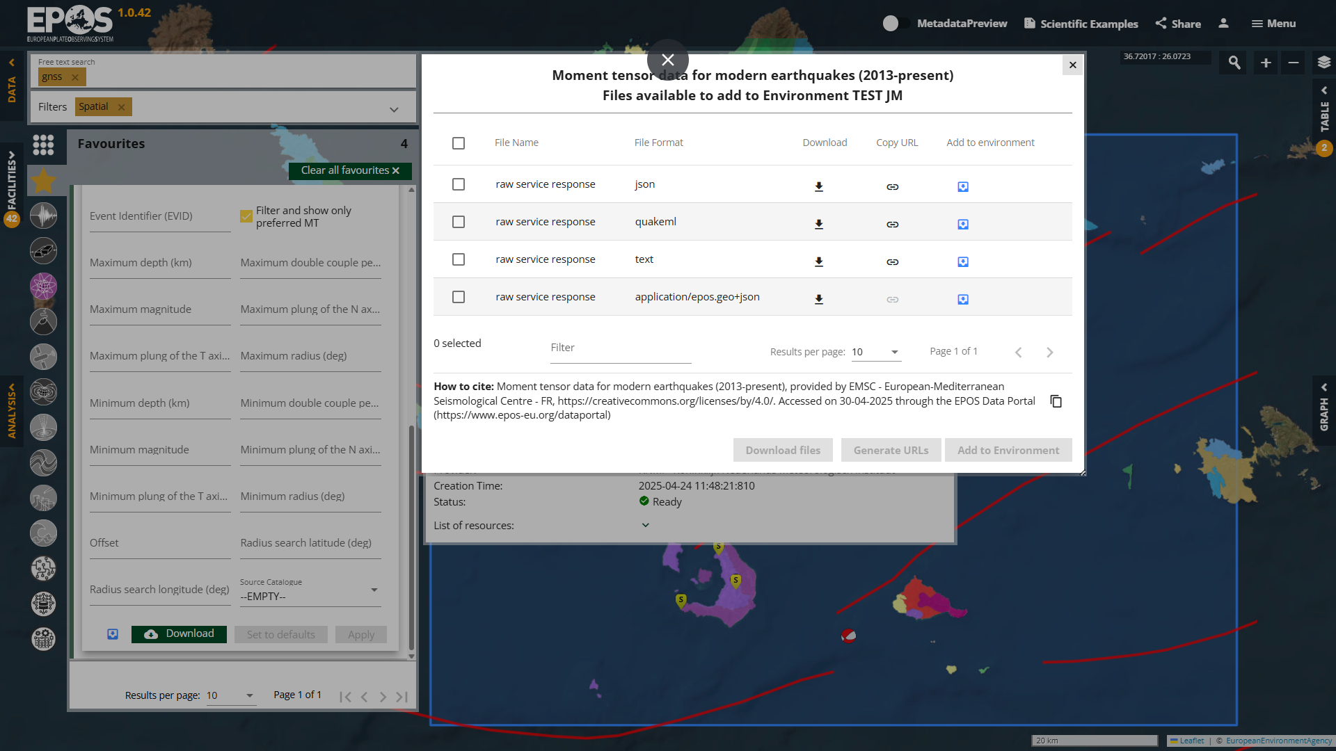

Slide 10
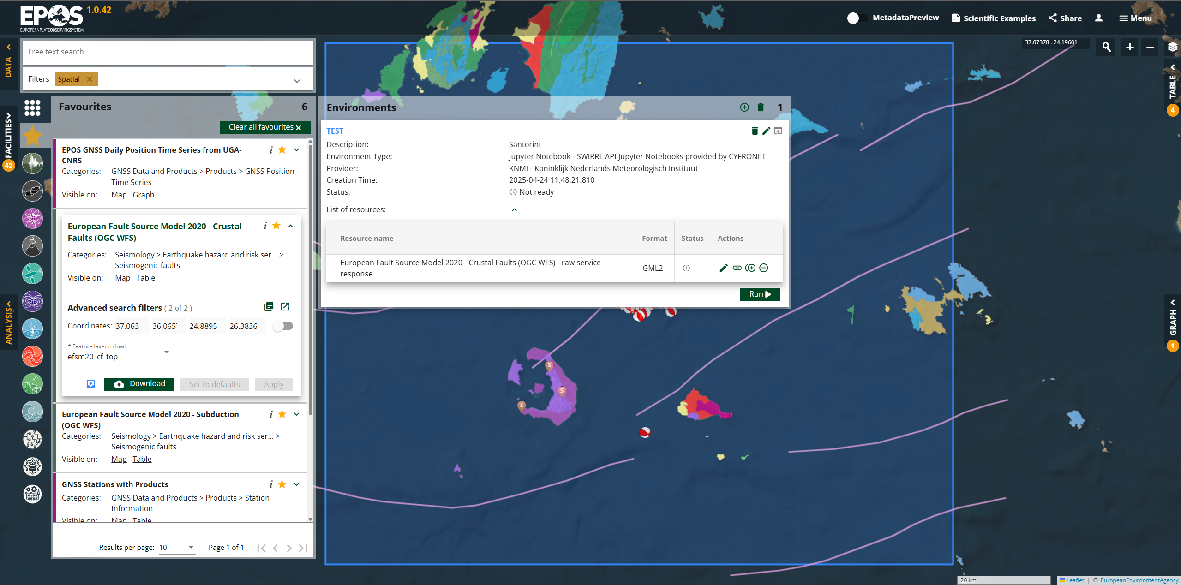

Slide 11
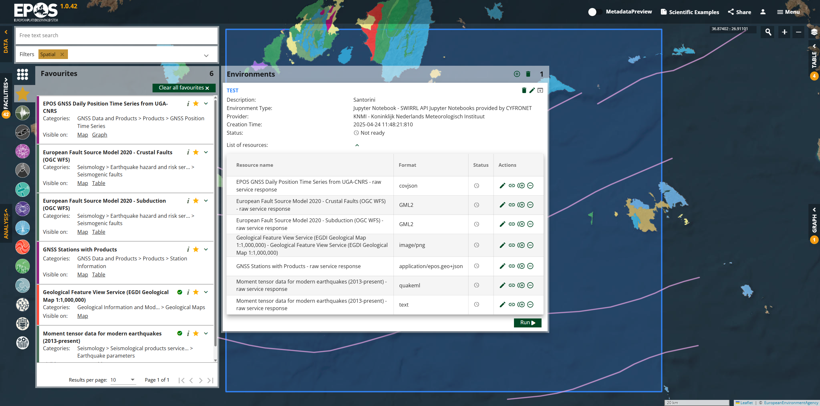

Slide 12
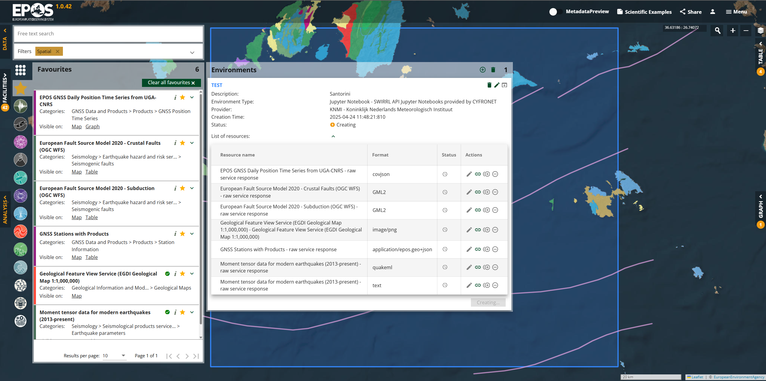

Slide 13
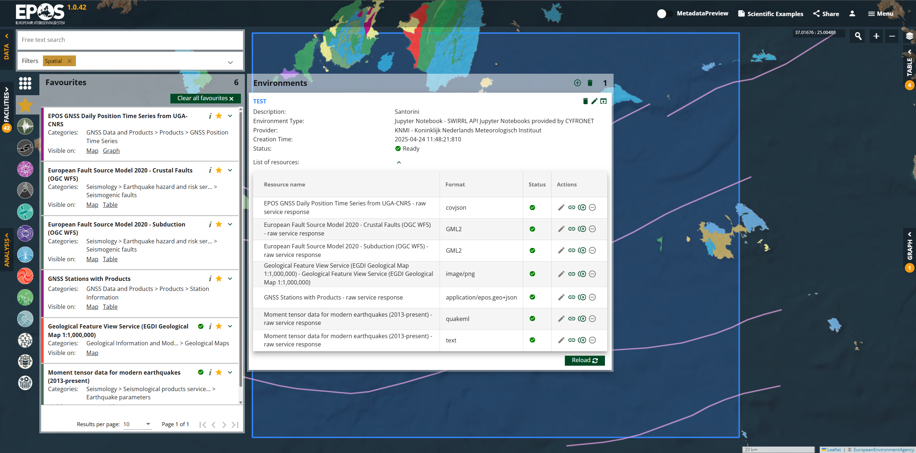

Slide 14
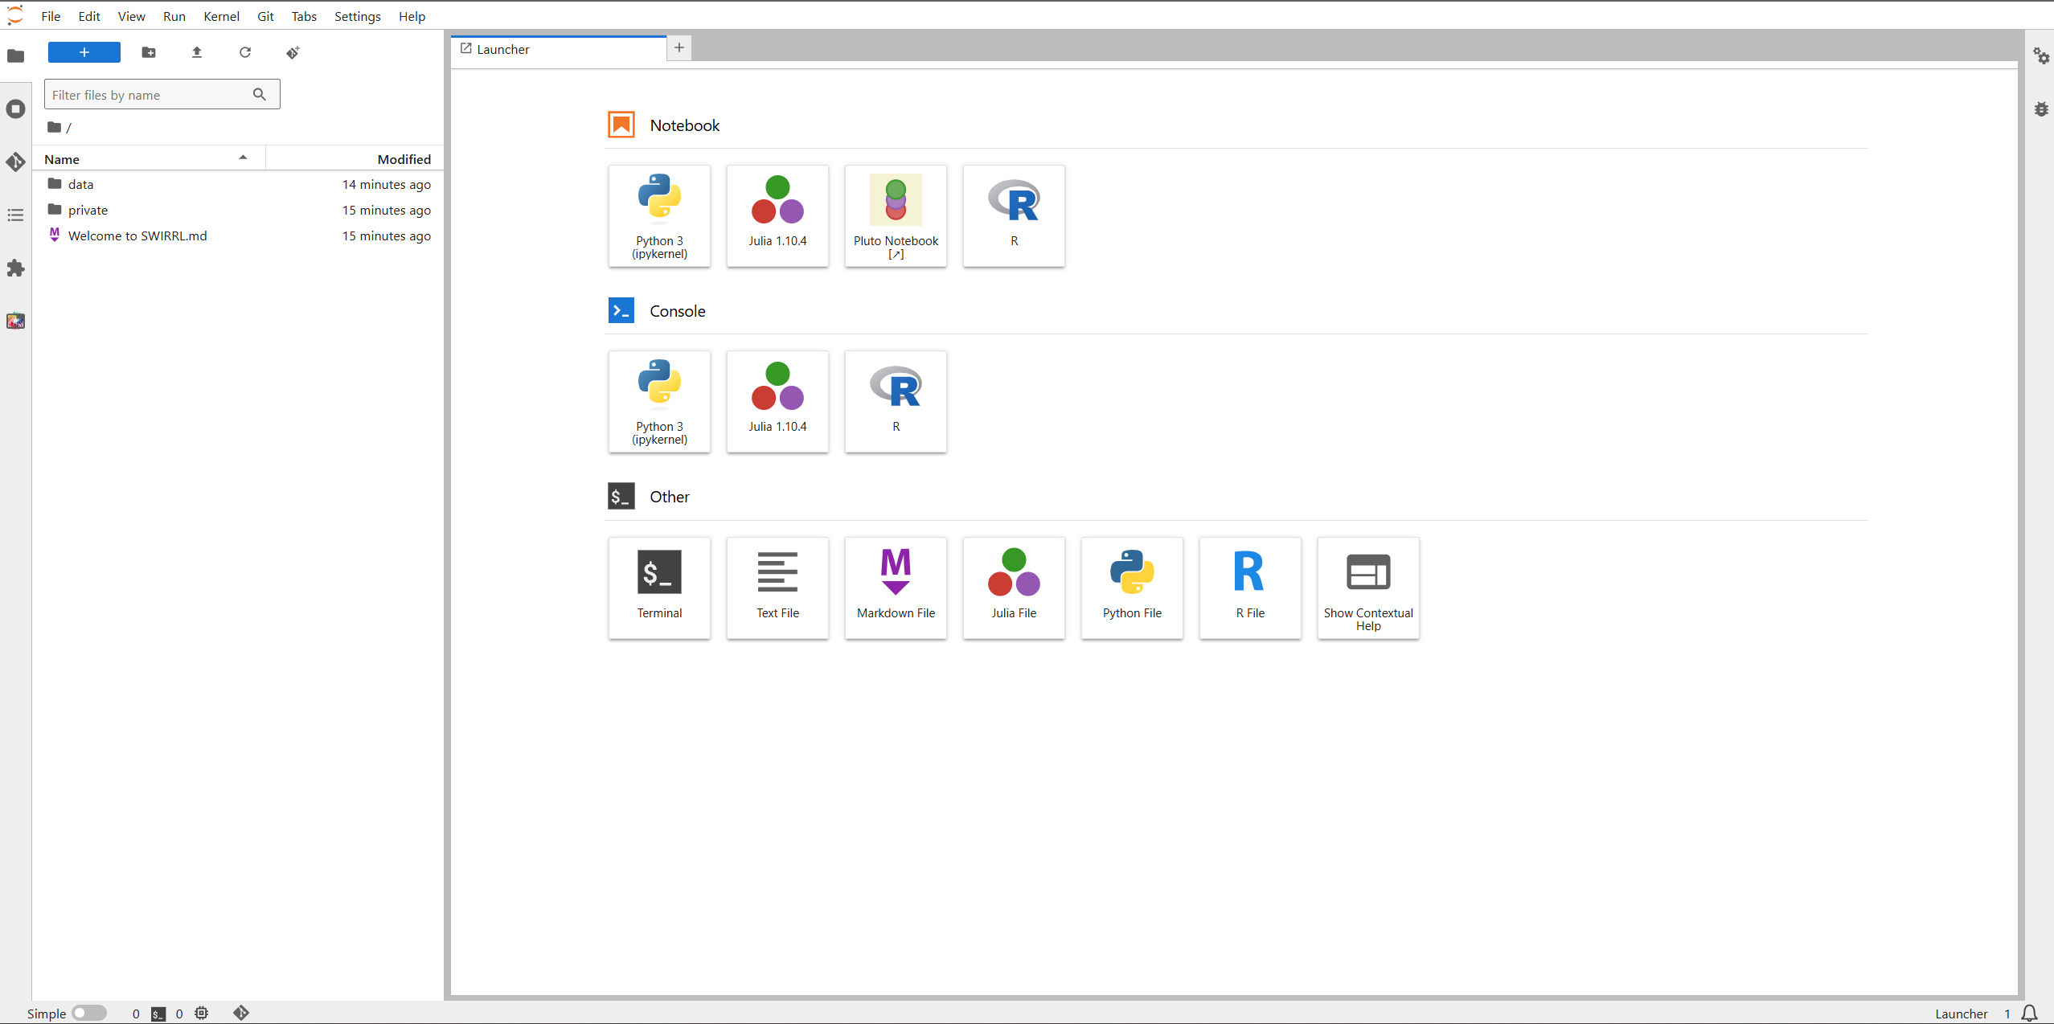

Slide 15
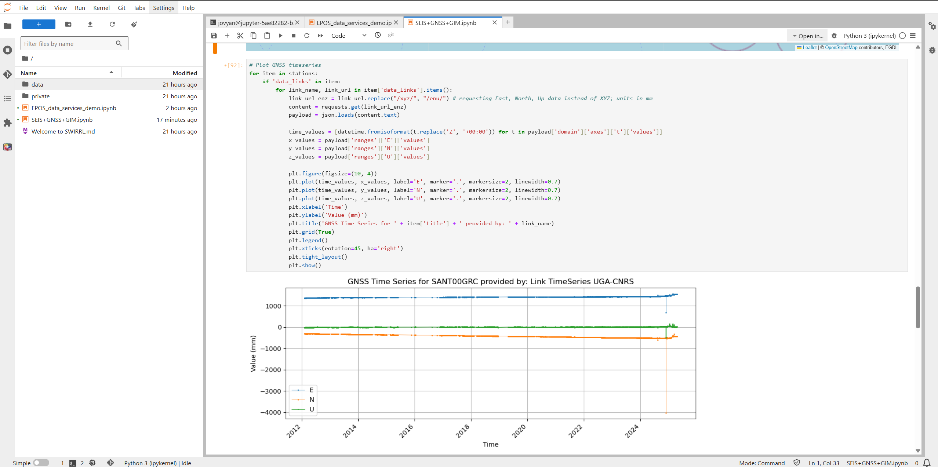

Slide 16
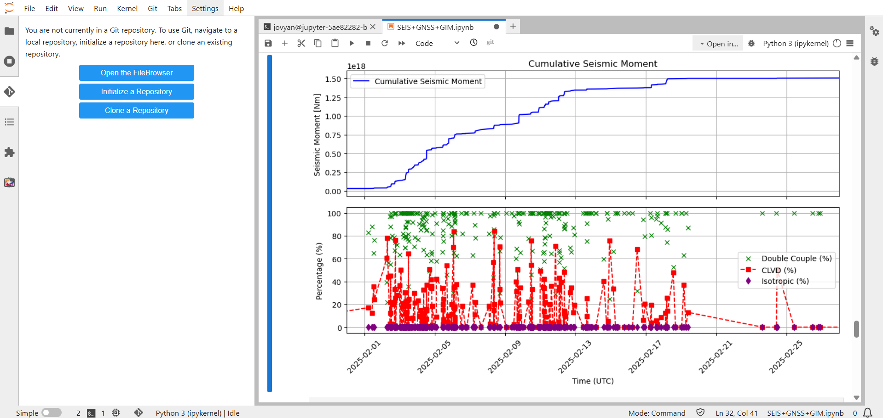
Cumulative seismic moment and DC, CLVD and ISO components in time

Slide 17
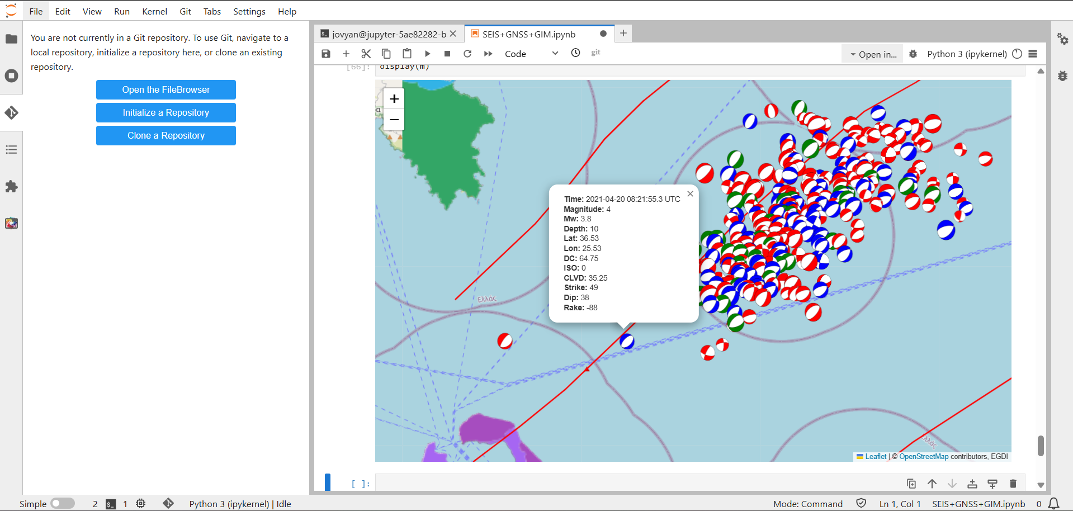
Interactive plot using folium library
Moment tensors scaled by magnitude and categorized by CLVD percentage: blue … > 20%; green … 10-20%; red … < 10%

Slide 18
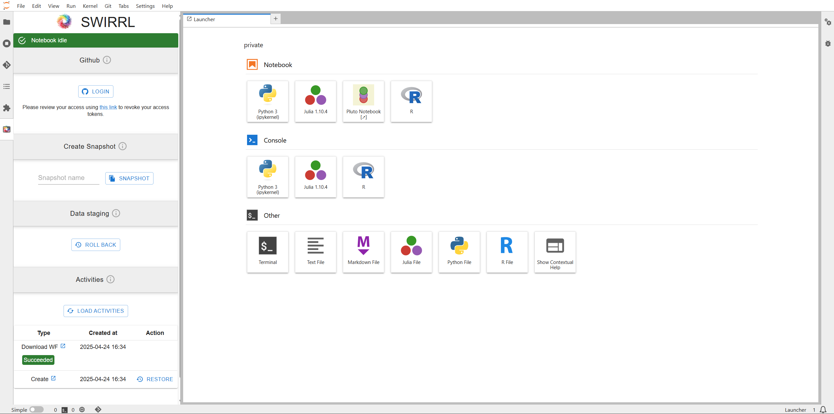

Slide 19
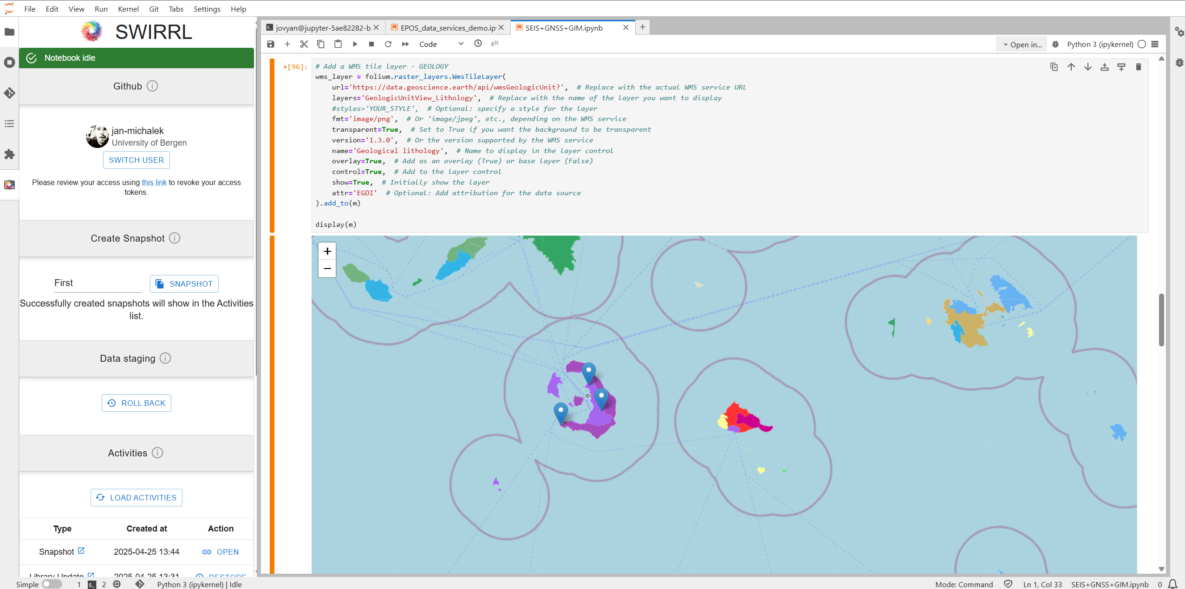

Slide 20
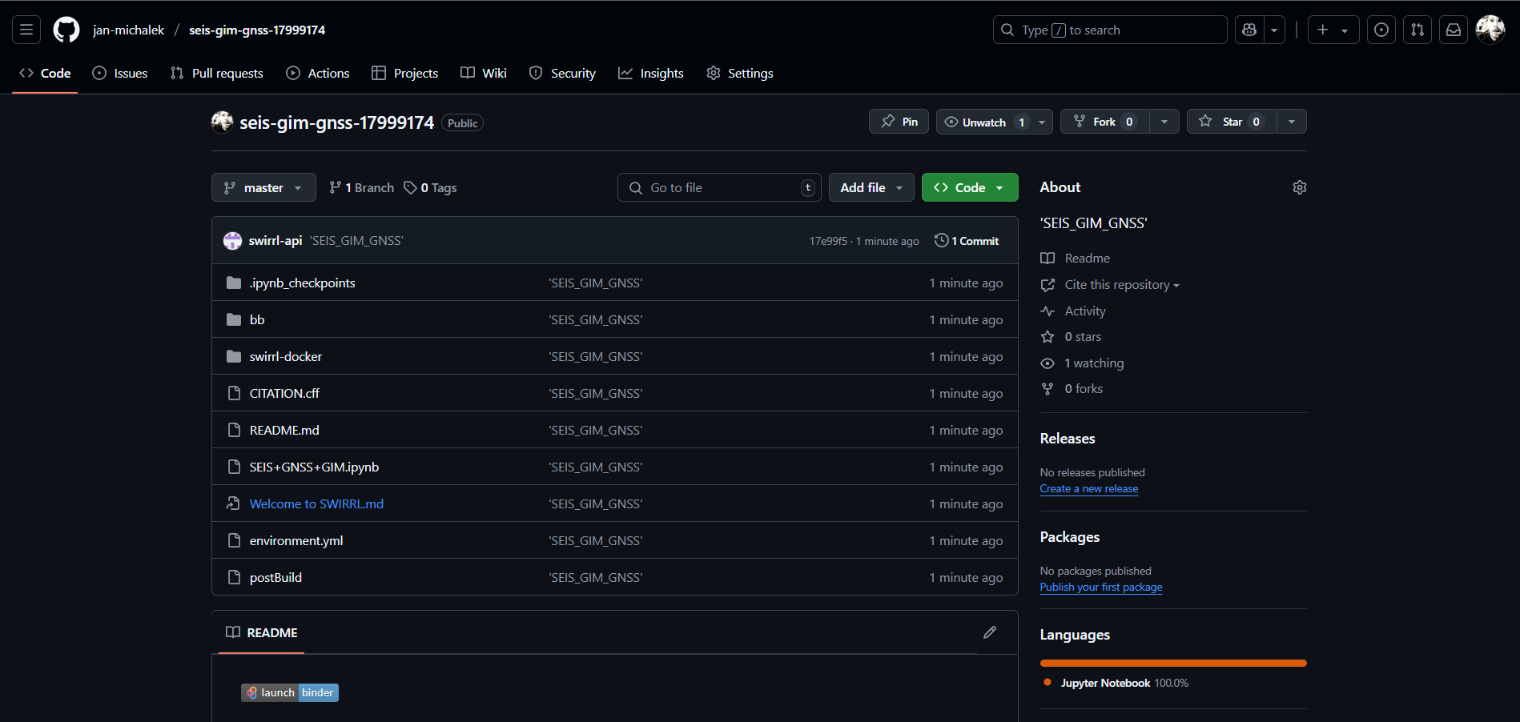
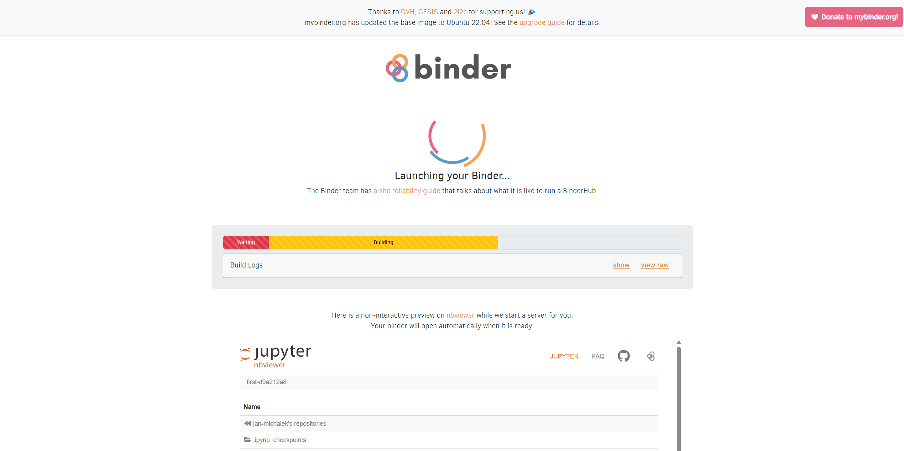
https://github.com/jan-michalek/seis-gim-gnss-17999174

Slide 21
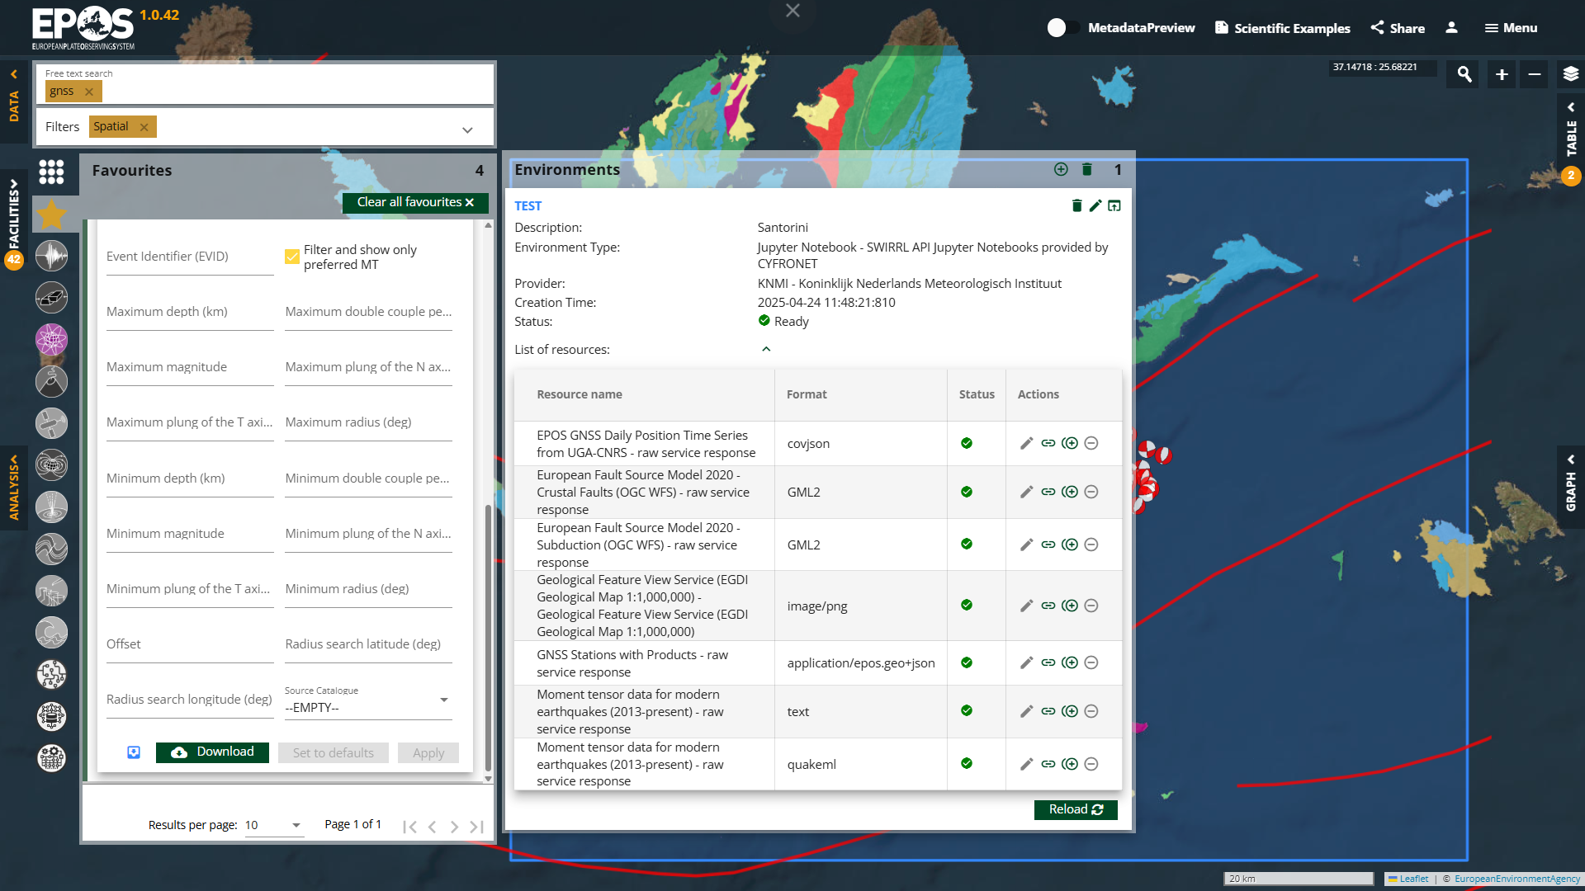
SOFTWARE

Slide 22
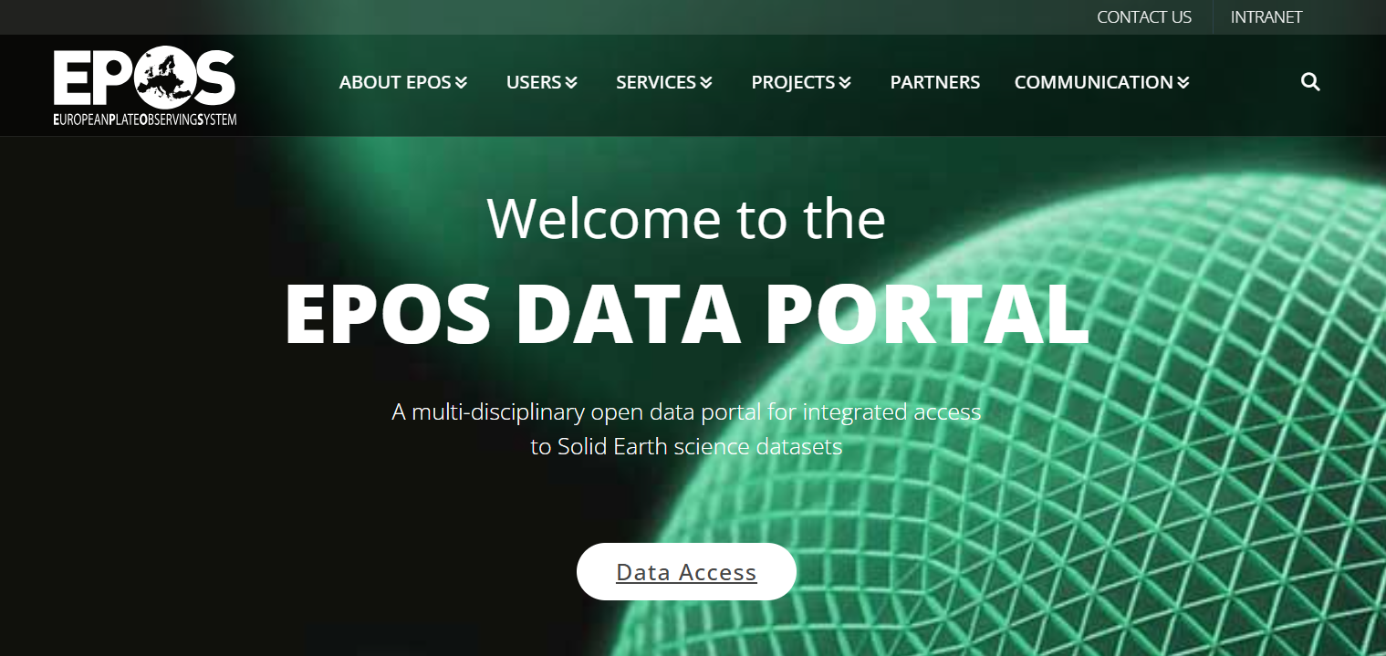

Thank you for your attention! epos-eu.org/dataportal

Slide 23
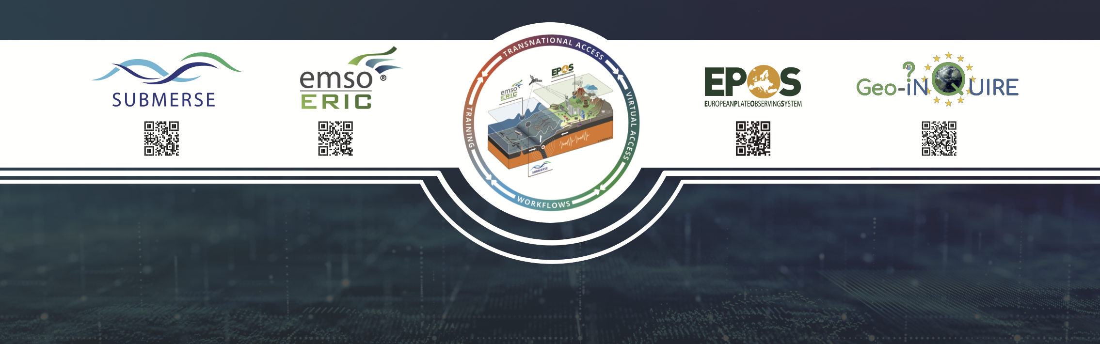
Curious to explore more?
Visit our joint booth (Stand #1) for Lunchtime presentations, Quiz games and little surprises…

